Slide 1




Database Application Development

Slide 2

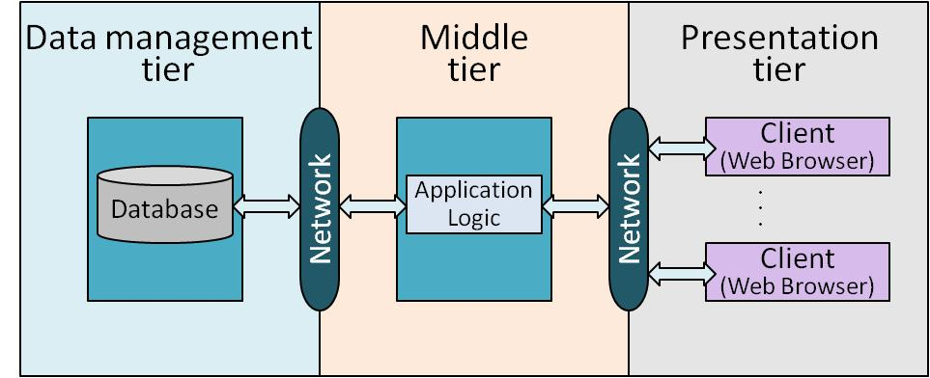
Outline
This chapter – How to use DBMS from applications
SQL in application code
Embedded SQL
Cursors
Dynamic SQL
JDBC
SQLJ
Stored procedures
Done!
Next chapter

Slide 3
Ad Hoc Query
SELECT S.sname, S.age
FROM Sailors S
WHERE S.rating > 6
sid | sname | rating | age
12 | dustin | 9 | 19
24 | brandon | 6 | 27
36 | emily | 7 | 32
45 | trevor | 6 | 21
Sailors

Slide 4
SQL in Application Code
Program
SQL commands can be called from within a host language (e.g., C++ or Java) program.
SQL statements can refer to host variables (including special variables used to return status).
:c_minrating = 6
SELECT S.sname, S.age
FROM Sailors S
WHERE S.rating > :c_minrating
sid | sname | rating | age
12 | dustin | 9 | 19
24 | brandon | 6 | 27
36 | emily | 7 | 32
45 | trevor | 6 | 21
Sailors

Slide 5



Relations
We will use these table definitions in this module
  Sailors(sid: integer, sname: string, rating: integer, age: real)
  Boats(bid: integer, bname: string, color: string)
  Reserves(sid: integer, bid: integer, day: date)
Make reservations

Slide 6
JDBC: API Approach
Client
  The Java-based driver uses java networking libraries to communicate directly with the database server (i.e., java sockets)
  The JDBC driver translates JDBC calls into native API of the database system
Java Application
JDBC API
Pure Java
JDBC call
JDBC Driver
Native API call via socket connec-tion
DBMS

Slide 7
JDBC Classes and Interfaces
Steps to submit a database query:
Load the JDBC driver
Connect to the data source
Submit SQL statements for processing
Java Application
3
JDBC API
JDBC Driver Manager
1
JDBC Driver 1
JDBC Driver 2
SQL Server
2
Oracle

Slide 8
JDBC Driver Management
DriverManager class:
  Maintains a list of currently loaded drivers
  Has methods to enable dynamic addition and deletion of drivers
Java Application
JDBC API
JDBC Driver Manager
JDBC Driver 1
JDBC Driver 2
DBMS1
DBMS2
Two ways of loading a JDBC driver:
  In the Java code:
  Class.forName(“oracle/jdbc.driver.Oracledriver”);
  /* This method loads an instance of the driver class
  Enter at command line when starting the Java application:
  -Djdbc.drivers=oracle/jdbc.driver

Slide 9
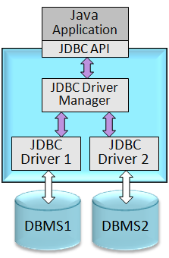
Connections in JDBC
We interact with a data source through sessions.
A session is started through creation of a Connection object
Connections are specified through a URL that uses the jdbc protocol - jdbc:<subprotocol>:<otherParameters>
Each connection identifies a logical session with a data source
Notes:
“Try …” discussed later

Slide 10
Connections in JDBC
We interact with a data source through sessions.
A session is started through creation of a Connection object
Connections are specified through a URL that uses the jdbc protocol - jdbc:<subprotocol>:<otherParameters>
Each connection identifies a logical session with a data source
Example:
String url=“jdbc:oracle:www.bookstore.com:3083”;
Connection con; /* Create a connection object
try{
con = DriverManager.getConnection(url,userId,password);
} catch(SQLException excpt) { …}
Host
Port
Different drivers have slightly different URL format - check the documentation
Con is a logical session with the Oracle database
Notes:
“Try …” discussed later

Slide 11
A Transactions
Transaction is an atomic sequence of database actions (reads/writes).
Since unprotected actions can be undone, they can be included in a higher-level operation (i.e., transaction), which as a whole has the Isolation properties.
Transaction (protected)
Begin Work
unproted action
unproted action
unproted action
unproted action
Commit Work

Slide 12
Four Isolation Levels
Multiple transactions update the same data item
More concurrency
Four isolation levels
Degree 0 - unrepeatable reads, dirty reads, lost updates
Degree 1 - unrepeatable reads, dirty reads
Degree 2 - unrepeatable reads
Degree 3 - true isolation
Reading updates made by transaction that has not finished
Computing aggregate function while other applications update the data
As long as applications know what they are doing, better performance can be achieved without causing anomalies
Example: Scanning a table does not repeat read operations anyway !

Slide 13
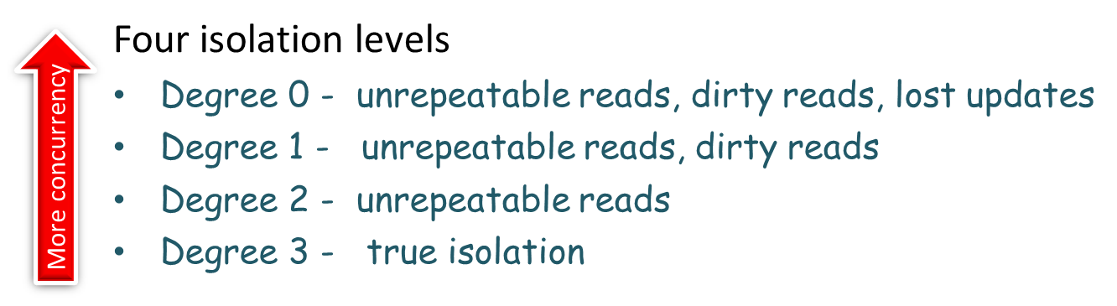
Connection Class Interface (1)
void setTransactionIsolation(int level)
Sets isolation level for the current connection
public int getTransactionIsolation()
Get isolation level of the current connection

Slide 14
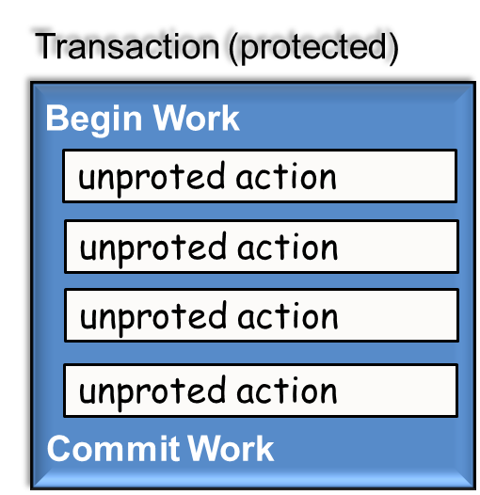
Connection Class Interface (1)
void setTransactionIsolation(int level)
Sets isolation level for the current connection
public int getTransactionIsolation()
Get isolation level of the current connection
void setReadOnly(boolean b)
Specifies whether transactions are read-only
public boolean getReadOnly()
Tests if transaction mode is read-only
void setAutoCommit(boolean b)
  If autocommit is set, then each SQL statement is considered its own transaction.
  Otherwise, a transaction is committed using commit(), or aborted using rollback().
public boolean getAutoCommit()
Test if autocommit is set

Slide 15
Connection Class Interface (2)
public boolean isClosed()
con.isClosed()
connectionname.close()
con.close()
Is the onnection ‘con’ still open?
Close the connection ‘con’

Slide 16
Executing SQL Statements
Three different ways of executing SQL statements:
  Statement (both static and dynamic SQL statements)
  PreparedStatement (semi-static SQL statements)
  CallableStatment (stored procedures)
PreparedStatement class:
  Used to create precompiled, parameterized SQL statements
SQL structure is fixed
Values of parameters are determined at runtime

Slide 17
PreparedStatement Object
Parameterized SQL
String sql=“INSERT INTO Sailors VALUES(?,?,?,?)”;
PreparedStatment pstmt=con.prepareStatement(sql);
“con” is a database object
Use the prepareStatement method to create an “SQL” object for con
SQL statements are submitted to DBMS as a parameter in an API call

Slide 18
PreparedStatement Object
Four parameters
Place holders
String sql=“INSERT INTO Sailors VALUES(?,?,?,?)”;
PreparedStatment pstmt=con.prepareStatement(sql);
pstmt.clearParameters();
pstmt.setInt(1,sid);
pstmt.setString(2,sname);
pstmt.setInt(3, rating);
pstmt.setFloat(4,age);
int numRows = pstmt.executeUpdate();
Good style to always clear
Setting parameter values.
sid, sname, rating, age are java variables
Number of rows modified
Use executeUpdate() when no rows are returned

Slide 19
PreparedStatement Object
String sql=“INSERT INTO Sailors VALUES(?,?,?,?)”;
PreparedStatment pstmt=con.prepareStatement(sql);
pstmt.clearParameters();
pstmt.setInt(1,sid);
pstmt.setString(2,sname);
pstmt.setInt(3, rating);
pstmt.setFloat(4,age);
int numRows = pstmt.executeUpdate();
Step 1: Write SQL
Step 2: Create SQL object
Step 3: Set the parameter values
Step 4: Submit the SQL

Slide 20



PreparedStatement Object
String sql=“INSERT INTO Sailors VALUES(?,?,?,?)”;
PreparedStatment pstmt=con.prepareStatement(sql);
pstmt.clearParameters();
pstmt.setInt(1,sid);
pstmt.setString(2,sname);
pstmt.setInt(3, rating);
pstmt.setFloat(4,age);
int numRows = pstmt.executeUpdate();
Buy a JDBC envelop
Insert content
USPS
SQL
Insert content
Drop the envelop
con
JDBC

Slide 21
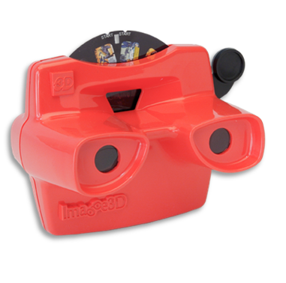
ResultSet
PreparedStatement.executeUpdate only returns the number of affected records
    int numRows = pstmt.executeUpdate();
PreparedStatement.executeQuery returns data, encapsulated in a ResultSet object
    ResultSet rs=pstmt.executeQuery();
  ResultSet provides a cursor to scan the items
    Allows us to read one row at a time
    Initially, the ResultSet is positioned before the first row
    Use next() to read the next row
    next() returns false if there are no more rows

Slide 22
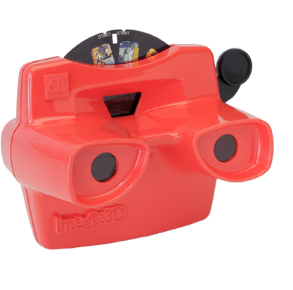
ResultSet Example
PreparedStatement
Object ‘pstmt’
ResultSet rs=pstmt.executeQuery();
// rs is now a cursor
While (rs.next()) {
// process the data
}
Use while loop to process one tuple each iteration until end of result set

Slide 23
Common ResultSet Methods (1)
POSITIONING THE CURSOR
next() | Move to next row
previous() | Moves back one row
absolute(int num) | Moves to the row with the specified number
relative(int num) | Moves forward or backward (if negative)
first() | Moves to the first row
Last() | Moves to the last row

Slide 24
Common ResultSet Methods (1)
Alternatively
rs.getString(2)
rs.getString(“sname”)
sid | sname | rating | age
12 | dustin | 9 | 19
24 | brandon | 6 | 27
36 | emily | 7 | 32
45 | trevor | 6 | 21
rs.next()
rs
emily

Slide 25
Common ResultSet Methods (2)
RETRIEVE VALUES FROM COLUMNS by NAME or INDEX
getString(string columnName): | Retrieves the value of designated column in current row
getInt(int columnIndex) | Retrieves the value of designated column in current row
Host variable
Column name
Example: String schoolname = rs.getString(“name”)
Notes:
getFloat(string columnName): Retrieves the value of the designated column in the current row of this ResultSet object as a float in the Java programming language.

Slide 26
Matching Java and SQL Data Types
SQL Type | Java class | ResultSet get method
BIT | Boolean | getBoolean()
CHAR | String | getString()
VARCHAR | String | getString()
DOUBLE | Double | getDouble()
FLOAT | Double | getDouble()
INTEGER | Integer | getInt()
REAL | Double | getFloat()
DATE | java.sql.Date | getDate()
TIME | java.sql.Time | getTime()
TIMESTAMP | java.sql.TimeStamp | getTimestamp()

Slide 27
Matching Java and SQL Data Types
SQL Type | Java class | ResultSet get method
BIT | Boolean | getBoolean()
CHAR | String | getString()
VARCHAR | String | getString()
DOUBLE | Double | getDouble()
FLOAT | Double | getDouble()
INTEGER | Integer | getInt()
REAL | Double | getFloat()
DATE | java.sql.Date | getDate()
TIME | java.sql.Time | getTime()
TIMESTAMP | java.sql.TimeStamp | getTimestamp()
Example: String schoolname = rs.getString(“name”)

Slide 28
SQL Data Types
BIT | A boolean value
CHAR(n) | A character string of fixed length n
VARCHAR(n) | A variable-length character string with a maximum length n
DOUBLE | A double-precision floating point value
FLOAT(p) | A floating point value with a precision value p
INTEGER | A 32-bit signed integer value
REAL | A high precision numeric value
DATE | A day/month/year value
TIME | A time of day (hour, minutes, second) value
TIMESTAMP | A day/month/year/hour/minute/second value

Slide 29
Statement Object – Another Way to
Execute an SQL Statement
Three different ways of executing SQL statements:
  Statement (both static and dynamic SQL statements)
  PreparedStatement (semi-static SQL statements)
  CallableStatment (stored procedures)
Statement stmt = con.createStatement();
// create an empty statement object
String query = "SELECT name, rating
FROM Sailors";
ResultSet rs = stmt.executeQuery(query);
Execute the Statement object stmt with the query inside

Slide 30
Statement Object – Another Way to
Execute an SQL Statement
Get a “Statement” envelop for the database con
Prepare the content
Statement stmt = con.createStatement();
// create an empty statement object
String query = "SELECT name, rating
FROM Sailors";
ResultSet rs = stmt.executeQuery(query);
Reply from con
Send out the envelop with the content

Slide 31
Statement Object – Another Way to
Execute an SQL Statement
The query can be dynamically created
Statement stmt = con.createStatement();
// create an empty statement object
String query = "SELECT name, rating
FROM Sailors";
ResultSet rs = stmt.executeQuery(query);

Slide 32
Review: Throwable Class
Throwable object: can have an associated message that provides more detail about the particular error or exception that is being thrown
getMessage(): returns the error message string of the throwable object
Throwable class: is the superclass of all errors and exceptions in the Java language
Java
Object
GetMessage()
Throwable
Exception
Error

Slide 33
Exception/Warning Class Hierarchy
GetMessage() returns the error message string of the throwable object
Java
Object
Throwable
GetSQLState() returns an SQLState identifier
Exception
Java.SQL
SQLException
GetWarning() retrieves SQL warning if they exist
SQLWarning

Slide 34
SQLException
Object
Java
Throwable
Most of the methods in java.sql can throw an exception of type SQLException if an error occurs
Exception
Java.SQL
SQLException
SQLWarning

Slide 35
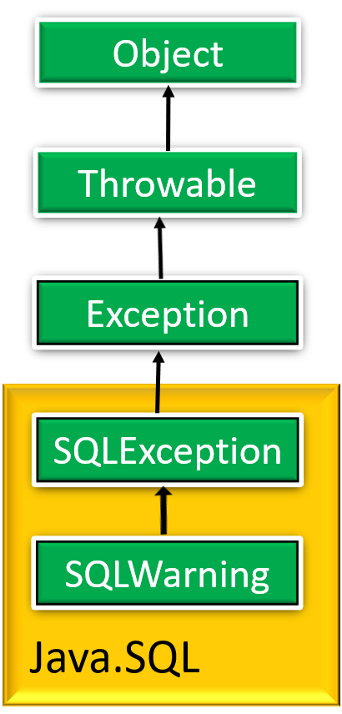

JDBC: Exceptions
SQLException has the following methods:
  public String getMessage()
  is inherited from the Throwable class
  public String getSQLState()
  returns an SQLState identifier
  public int getErrorCode()
  retrieves a vendor-specific error code
  public SQLException getNextException()
  gets the next exception chained to this SQLException object

Slide 36
Catch the Exception
The class name of the exception we want to handle, e.g., SQLException
Contains code that might throw the exception
try {
body-code
} catch ( exception-classname variable-name) {
handler-code
}
The variable that will hold the exception object
Contains the code to execute if the exception occurs

Slide 37
JDBC: Warnings
SQLWarning is a subclass of SQLException.
Warnings are not as severe. They are not thrown and their existence has to be explicitly tested.
  getWarnings()
  retrieves SQL warning if they exist
  getNextWarning()
  retrieves the next warning chained to
  this SQLwarning object
Notes:
Warnings do not stop the execution of an application, as exceptions do; they simply alert the user that something did not happen as planned. For example, a warning might let you know that a privilege you attempted to revoke was not revoked. Or a warning might tell you that an error occurred during a requested disconnection.

Slide 38
Warning & Eception Example
try {
stmt=con.createStatement(); // create an empty statement object
warning=con.getWarnings(); // retrieve warning if it exists
while(warning != null) {
// handle SQLWarnings
warning = warning.getNextWarning();
// get next warning chained to the warning object
}
con.clearWarnings();
stmt.executeUpdate(queryString);
warning = con.getWarnings();
…
} //end try
catch( SQLException SQLe) { // catch the SQLException object
// handle the exception
}

Slide 39

Another Example
  Sailors(sid: integer, sname: string, rating: integer, age: real)
Print names and their rating

Slide 40
Another Example
  Sailors(sid: integer, sname: string, rating: integer, age: real)
Connection con = // connect
DriverManager.getConnection(url, ”login", ”pass");
Statement stmt = con.createStatement(); // create and execute a query
String query = "SELECT name, rating FROM Sailors";
ResultSet rs = stmt.executeQuery(query);
try {
while (rs.next()){ // loop through result tuples
String s = rs.getString(“name"); // get the attribute values by name
Int n = rs.getInt(“rating");
System.out.println(s + " " + n); // print name and rating
}
} catch(SQLException ex) { // handle exceptions
System.out.println(ex.getMessage ()
+ ex.getSQLState () + ex.getErrorCode ());
}
rs works like a cursor

Slide 41
Executing SQL Statements
Three different ways of executing SQL statements:
  Statement (both static and dynamic SQL statements)
  PreparedStatement (semi-static SQL statements)
  CallableStatment (stored procedures)

Slide 42
Stored Procedures
What is a stored procedure ?
  Program executed through a single SQL statement
  Executed in the process space of the server
Client/Server
Embedded SQL
Stored Procedure
Computer 1
Client
Computer 1
Application
Computer 1
Application
part 1
Remote
procedure
call
Queries
& cursors
Remote
procedure
call
Stored procedure
Computer 2
Server
Computer 2
DB Server
Computer 2
Application
part 2
Queries
& cursors
DBMS
DB Server

Slide 43
Stored Procedures: Advantages
Can encapsulate application logic while staying “close” to the data
  Less inter-process communication
Avoid tuple-at-a-time return of records through cursors
  Less network communication
Reuse of application logic by different users
Computer 1
Application
part 1
2
Remote
procedure
Call (RPC)
Stored procedure
Computer 3
Another application
RPC
Application
part 2
3
1
Queries
& cursors
Stored procedures can be called from JDBC using CallableStatement object
DB Server
Computer 2

Slide 44
SQL/PSM: Persistent Stored Modules
A standard for coding stored procedures, and storing them in the database itself
A mixture of conventional statement (if, while, etc.) and SQL
Declare a stored procedure:
CREATE PROCEDURE <name>(<parameter list>)
<local variable declarations>
procedure code;
Declare a stored function:
CREATE FUNCTION <name>(<parameter list>)
RETURNS sqlDataType
<local variable declarations>
function code;

Slide 45
Parameters in SQL/PSM
The parameters must be valid SQL types
Unlike the usual name-type pairs in conventional languages, e.g.,
  Name String
  Rating Integer
PSM uses mode-name-type triples, e.g.,
  IN StudentID Integer
Three different modes in PSM:
  IN parameters are arguments to the stored procedure
  OUT parameters are returned from the stored procedure
  INOUT parameters combine the properties of IN and OUT parameters

Slide 46
Main SQL/PSM Constructs
Local variables (DECLARE <name> <type>)
RETURN values for FUNCTION (Unlike C, etc., it does not terminate function execution)
Assign variables with SET <variable> = <expression>
Branches and loops:
  IF (condition) THEN statements;
  ELSEIF (condition) statements;
  … ELSE statements; END IF;
  LOOP statements; END LOOP
Queries can be parts of expressions
Can use cursors naturally

Slide 47

SQL/PSM – Function Example
CREATE FUNCTION rateSailor (IN sailorId INTEGER)
RETURNS INTEGER
DECLARE rating INTEGER // two local variables
DECLARE numRes INTEGER
BEGIN
SET numRes = (SELECT COUNT(*)
FROM Reserves R
WHERE R.sid = sailorId);
IF (numRes > 10) THEN rating =1;
ELSE rating = 0;
END IF;
RETURN rating;
END;
NO “EXEC” anywhere
BEGIN … END for groups of statements
SQL can be part of an expression

Slide 48
SQL/PSM: Procedure Examples
CREATE PROCEDURE ShowNumReservations (
IN sailorid INTEGER, OUT numres INTEGER )
SET numres = (SELECT COUNT(*)
FROM Reserves R
WHERE R.sid = sailorid)
CREATE PROCEDURE IncreaseRating(
IN sailor_sid INTEGER, IN increase INTEGER )
UPDATE Sailors
SET rating = rating + increase
WHERE sid = sailor_sid

Slide 49
SQL/PSM: Returning Result Set
<declare cursor> statement is used to return a result set
The result set is returned to JDBC CallableStatement object that calls the procedure
CREATE PROCEDURE Goodsailors(
IN goodrating INTEGER)
DYNAMIC RESULT SETS 1
BEGIN
DECLARE Cur1 CURSOR WITH RETURN FOR
SELECT sid, sname, rating
FROM Sailors S
WHERE S.rating > goodrating;
OPEN Cur1
END
Maximum number of result sets is 1
Make sure to open cursor in order to return the result set
Result set will be returned
Notes:
A stored procedure can return more than just one result set.

Slide 50
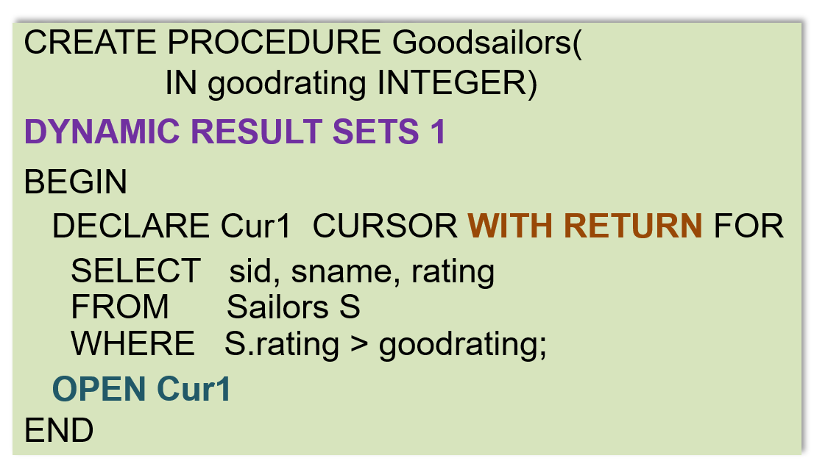
Preparation for Calling Stored Procedure
The stored procedure is executed with a JDBC CallableStatement execute() method
(next slide)
Stored procedure
1
Preperation for calling the stored procedure Goodsailors
Import java.sql.CallableStatement;
…
CallableStatement CStmt = con.prepareCall(“{Call Goodsailors(?)”);
CStmt.setInt(“goodrating”, 8); // Set parameter using its name
2

Slide 51




Returning Multiple Result Sets
A stored procedure may return multiple result sets
DBMS
Notes:
A stored procedure may return more than one result set

Slide 52
Processing Multiple Result Sets
A stored procedure may return multiple result sets
All the result sets that were opened are returned to the CallableStatement object CStmt
Calling getResultSet() returns the current result set
Boolean hadResults = CStmt.execute();
while (hadResults) {
ResultSet rs = CStmt.getResultSet();
// process result set
hadResults = CStmt.getmoreResults();
}
Calling getMoreResultsets() to move to the next result set
Notes:
A stored procedure may return more than one result set

Slide 53
Execute() vs. executeQuery()
Boolean execute()
Executes the SQL statement which may be any kind of SQL statement
(e.g., can be an update)
May return multiple result sets
Boolean hadResults = CStmt.execute();
while (hadResults) {
ResultSet rs = CStmt.getResultSet();
// process result set
hadResults = CStmt.getmoreResults();
}

Slide 54
Execute() vs. executeQuery()
Boolean execute()
Executes the SQL statement which may be any kind of SQL statement
(e.g., can be an update)
ResultSet executeQuery()
Executes the SQL statement and returns the ResultSet object generated by the query (only one result set)
Return only one result set
JDBC:
CallableStatement cstmt=
con.prepareCall(“{call ShowSailors}”);
ResultSet rs = cstmt.executeQuery();
while (rs.next()) {
… // process result set
}

Slide 55
Stored Procedures in Java
Stored procedure do not have to be written in SQL
The following stored procedure in Java is dynamically executed by the database server whenever it is called by the client
CREATE PROCEDURE TopSailors(
IN num INTEGER)
LANGUAGE Java
EXTERNAL NAME “file:///c:/storedProcs/rank.jar”
The language in which the routine is written
Specifies the program that runs when this procedure is called

Slide 56
JDBC Summary: 5 Steps
Load the JDBC driver
Create a database Connection object (your database) using the DriverManager
Create a Statement, PreparedStatement, or CallableStatement object that contains the SQL statement (your query object)
Execute the SQL Statement object, and receive the result in a ResultSet object
Step through the rows in ResultSet object and process the data in the host language

Slide 57
Another Option ?
API Approach: JDBC
Embedded SQL: SQLJ
  Do not need to learn the different “envelops”

Slide 58

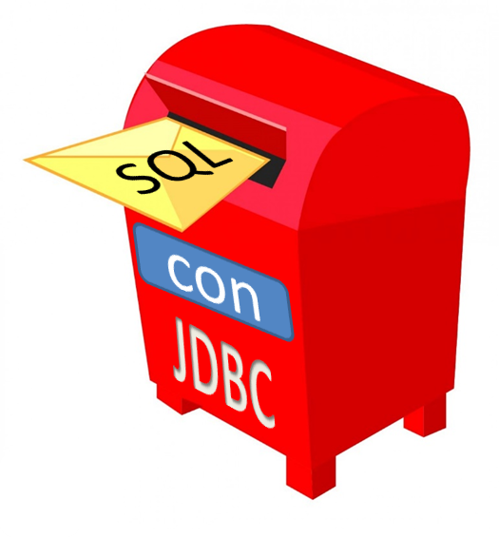
SQLJ: Java with Embedded SQL
Java program
#SQL …
#SQL …
SQLJ Preprocessor
SQLJ is part of the SQL standard
Function call in Java
Java program
API CALL …
Industry standard
JDBC Driver
DBMS

Slide 59
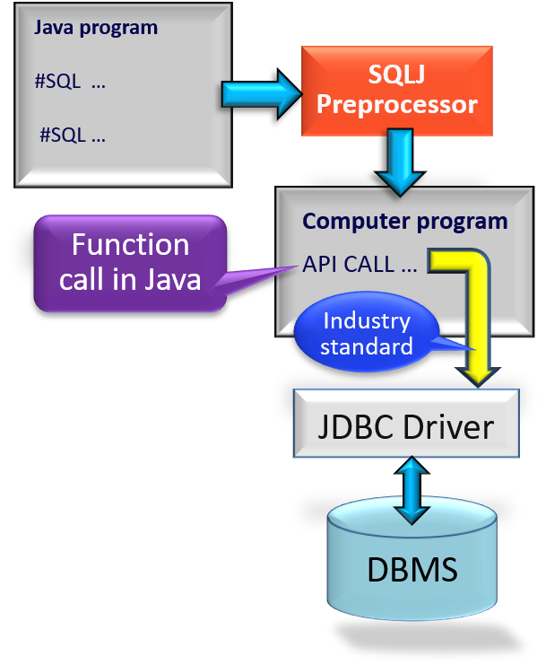
SQLJ Precompiler
SQLJ applications are pre-processed through an SQLJ translation program
  Replaces embedded SQLJ code with calls to an SQLJ Java library
  Usually, the SQLJ Java library makes calls to a JDBC driver (standard interface)
  The modified program code can then be compiled by any Java compiler
Applications using SQLJ are DBMS-independent at the source code level and at the level of the executable

Slide 60
Using SQLJ
Every SQLJ statement has the special prefix #sql
We submit a query and retrieve the results through an iterator objects (basically a cursor)
Usage of an iterator goes through five steps:
  Declare the Iterator Class
  Example: #sql iterator Sailors (Int sid, String name, Int rating);
  Instantiate an iterator object from the new iterator class
  Example: Sailors sailors;
  Initialize the iterator using an SQL statement (i.e., submit the query)
  Example: #sql sailors = {SELECT sid, sname, rating FROM … WHERE …}
  Iteratively, read the rows from the iterator object (i.e., receive results)
  Example: while (sailors.next()) { // process row }
  Close the iterator object
  Example: sailors.close();

Slide 61
SQLJ Variables
Complements JDBC with a (semi-)static query model
  SQLJ - All arguments always bound to the same variable:
  #sql sailors = {
  SELECT name, rating INTO :name, :rating // name is bound
  FROM Sailors WHERE sid = :sid; } // to variable :name
  Compare to JDBC:
  sid=rs.getInt(1); // get value of first attribute, i.e., sid
  if (sid==1) { sname1=rs.getString(2); } // name can be assigned to
  else { sname2=rs.getString(2); } // different variable
  Compiler can perform syntax checks, strong type checks, consistency of the query with the schema
Host variable
  Sailors(sid: integer, sname: string, rating: integer, age: real)

Slide 62
SQLJ Example
Named iterator allows retrieval of columns by name
Int sid; String name; Int rating;
// (1) declare the iterator class
#sql iterator Somesailors(Int sid, String name);
Somesailors mysailors; // (2) intantiate an iterator object
rating = 7
#sql mysailors = {
SELECT sid, sname INTO :sid, :name
FROM Sailors WHERE rating = :rating }; // (3) initialize iterator
while (mysailors.next()) { // (4) retrieve rows from iterator object
System.out.println(mysailors.sid + “ “ + mysailors.name));
}
mysailors.close(); // (5) close the iterator object

Slide 63

Two Types of SQLJ Iterators
Named iterator
  Example in last slide
  Need to specify both the variable type and the name of each column of the iterator
  This allows retrieval of columns by name.
Positional iterator
  Need to specify only the variable type of the iterator, and then FETCH .. INTO construct:
  #sql iterator Sailors(Int, String, Int);
  Sailors mysailors;
  #sql mysailors = { SELECT … FROM … WHERE … };
  while (true) {
  #sql {FETCH :mysailors INTO :sid, :name} ; // fetch next sailor
  if (mysailors.endFetch()) { break; } // exit loop if end of iterator
  // process the sailors }
#sql iterator Somesailors(Int sid, String name);
1
2
1
2

Slide 64
Calling Stored Procedure from
JDBC & SQLJ
A query object
A query class
JDBC:
CallableStatement cstmt=
con.prepareCall(“{call ShowSailors}”);
ResultSet rs = cstmt.executeQuery();
while (rs.next()) {
… // process result set
}
SQLJ:
#sql iterator SailorInfo(…);
SailorInfo sailorinfo;
#sql sailorinfo={CALL ShowSailors};
while (sailorinfo.next()) {
…
}
Call stored procedure
A query object
Call stored procedure
Note: con is the database
Call procedure instead of writing SQL
Notes:
SQLJ Preprocessor generates the JDBC code from the SQLI code in the right

Slide 65
MySQL System Catalog
System catalog is a system schema called INFORMATION_SCHEMA
It contains tables that can be queried for metadata about the tables and other things in any schema (e.g., MyDatabase) in MySQL
SELECT TABLE_NAME, TABLE_ROWS
FROM INFORMATION_SCHEMA.TABLES
WHERE TABLE_SCHEMA = ‘MyDatabase’;
Retrieve name and size of the tables in the MyDatabase database
Information about tables

Slide 66
JDBC Metadata
DatabaseMetaData object gives information about the database system such as table names and table’s columns.
DatabaseMetaData md = con.getMetaData();
// print information about the driver:
System.out.println(
“Name:” + md.getDriverName() +
“version: ” + md.getDriverVersion());
Your database

Slide 67
JDBC Catalog and Schema
According to JDBC, a database may have a set of catalog and each catalog may have a set of schemas (i.e., concepts for grouping tables).
Schema
Table
Catalog
Schema
Table
A Database
Table
Schema
Catalog

Slide 68
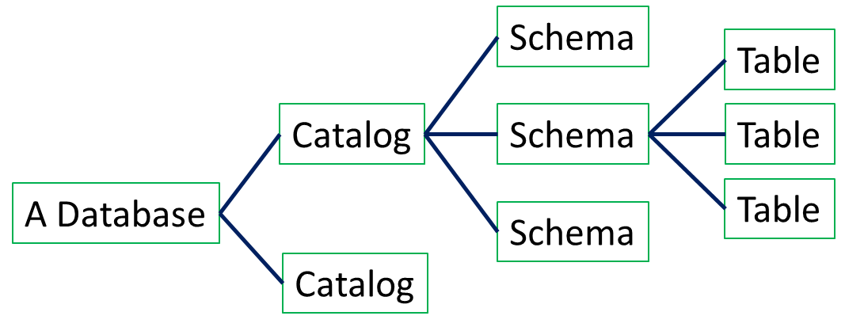
JDBC Catalog and Schema
getTables(catalog, schema, tableNames, columnNames) | Returns table names for all tables matching tableNames and all columns matching columnNames
getColumns(catalog, schema, tableNames, columnNames) | Returns table column names for all tables matching tableNames and all columns matching columnNames
Ex: “getTables(null,null,null,null)” gets information for all tables
Ex: “getColumns(null,null,tableName,null)” gets all attributes of tableName

Slide 69
JDBC Catalog and Schema
Different DBMS’s may have different semantics by using the same JDBC API
You have to test your code against different DBMS’s.
According to JDBC, a database may have a set of catalog and each catalog may have a set of schemas (i.e., concepts for grouping tables).
getTables(catalog, schema, tableNames, columnNames) | Returns table names for all tables matching tableNames and all columns matching columnNames
getColumns(catalog, schema, tableNames, columnNames) | Returns table column names for all tables matching tableNames and all columns matching columnNames
Ex: “getTables(null,null,null,null)” gets information for all tables
Ex: “getColumns(null,null,tableName,null)” gets all attributes of tableName

Slide 70
Catalog and Schema
In MySQL, DATABASE and SCHEMA are synonyms. It is a “folder” for tables, views, constraints, triggers, and stored procedures)
  CREATE SCHEMA TheDatabase;
  USE TheDatabase
  CREATE TABLE FirstTable (…); …
Some other vendors treat the terms DATABASE and SCHEMA differently
Some vendors also have a term “CATALOG” (used to group schemas). MySQL does not support this concept
Notes:
CREAT SCHEMA is synonym for CREAT DATABASE in MySQL

Slide 71
Some DatabaseMetaData Methods
134 methods in JDBC 2.0
getCatalogs(): retrieves catalog names available in this database
getIndexInfo(): retrieves a description of the indexes and statistics for the given table
getTables(): retrieves a description of the tables available in the given catalog
GetColumns(): retrieves a description of table columns available in the specified catalog
getPrimaryKeys(): retrieves a description of the given table’s primary key columns.

Slide 72
Print names of tables and their columns
(Using MySQL)
DatabaseMetaData md=con.getMetaData();
ResultSet trs=md.getTables(null,null,null,null); // get all tables
String tableName;
While(trs.next()) { // for each table, do …
tableName = trs.getString(“TABLE_NAME”); // get TABLE_NAME field
System.out.println(“Table: “ + tableName);
ResultSet crs = md.getColumns(null,null,tableName,null);
// get all attributes of tableName
while (crs.next()) {
System.out.println(crs.getString(“COLUMN_NAME”) + “, “);
}
}
trs
TABLE_NAME
…
crs
Table1
…
COLUMN_NAME
…
Table2
…
sid
…
Print the columns of each table in con
Sailors
…
sname
…
Table3
…
rating
…
Table4
…
age
…
Table5
…
Notes:
trs stands for “table returned string” crs stands for “column returned string”

Slide 73
SUMARY - SQL in Application Code
Pure JAVA
Need preprocessor
Java program
with JDBC
Java program
PreparedStatement
SQLJ
SQL
Statement
CallableStatement
Iterator
Call
#SQL
#SQL
executeQuery
Call
executeQuery
JDBC
SQL/PSM
Procedure
ResultSet
ResultSet
DBMS

Slide 74
Summary
JDBC introduces a layer of abstraction (APIs) between application and DBMS
Cursor mechanism allows retrieval of one record at a time from the query result
SQLJ: Static model, queries checked at compile-time.
Stored procedures execute application logic directly at the server
SQL/PSM is a standard for writing stored procedures

